Slide 1
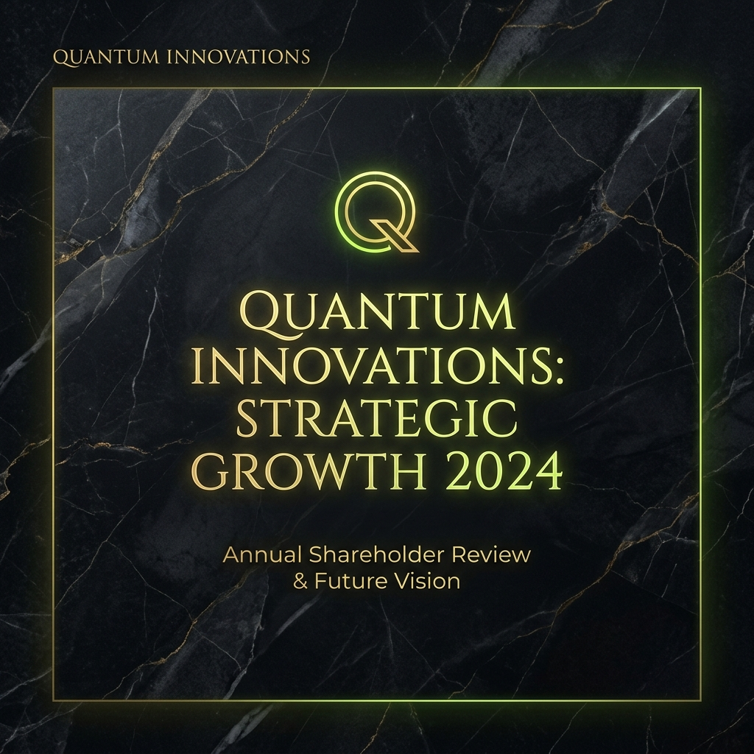
THE SOVEREIGN INSIGHT
Strategic Presentation Deck v2.7
Youth Startup Flow Analysis Engine

Slide 2
MULTI-PLATFORM ECOSYSTEM
Web Dashboard (React + Vite)
- High-Resolution Geo-Data Visualization - Dynamic Scenario Simulation
Mobile Insight App (Flutter)
- Real-time Scouting & AR Support - Persona-based Personalized Analysis

Slide 3
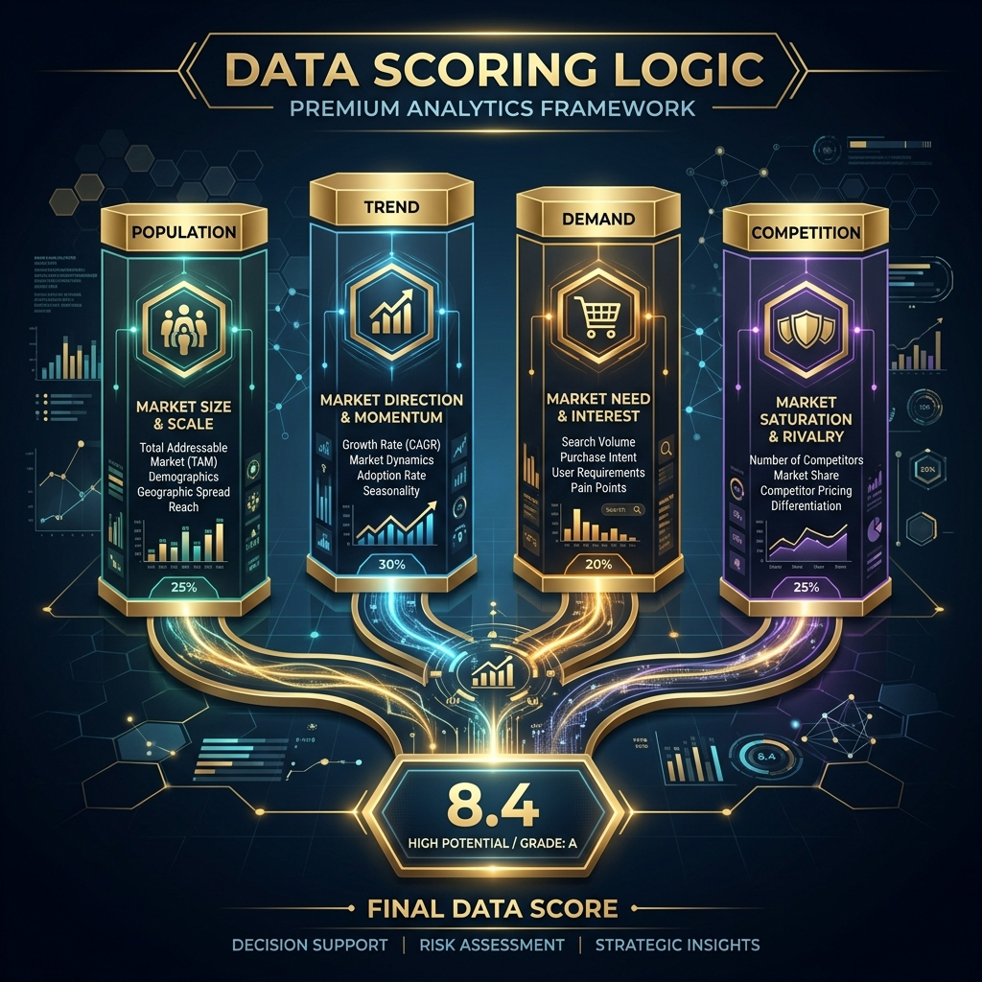
INTEGRATED SCORING ENGINE LOGIC
4 Core Pillars:
1. Population (실시간 유동인구)
2. Demand (네이버 검색 수요)
3. Trend (블로그 감성 분석)
4. Competition (상가 생존 시뮬레이션)
Final Score = Public(60%) + SNS(40%)

Slide 4
DISTRICT PRECISION REPORT: SEONGSU
AI Match Score: 84.5 pts
Gentrification Risk: LOW
Est. BEP Period: 18 months
Strategic Insight: '성수동 연무장길 상권은 현재 감성 폭발형 성장 단계의 초입에 위치해 있습니다.'

Slide 5
VISUAL DNA RECOMMENDATIONS

Slide 6
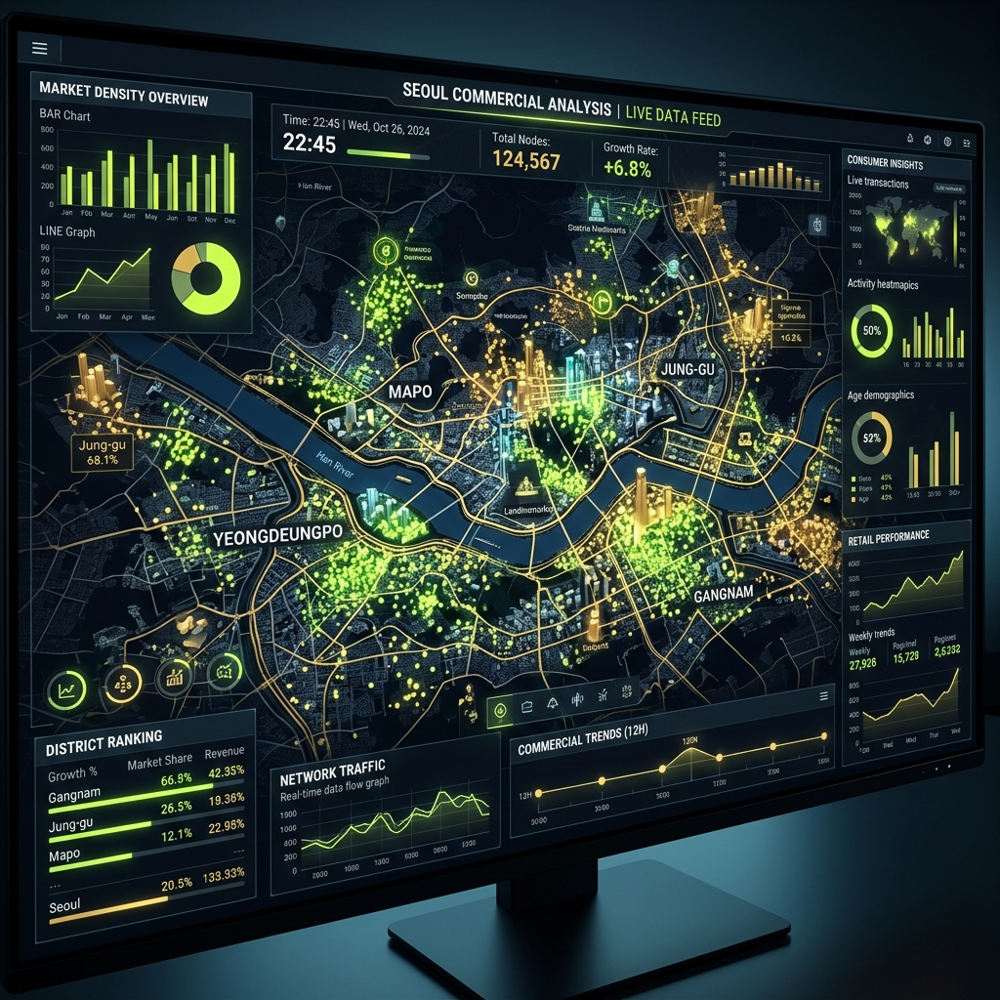
AI CLUSTERING & FUTURE SCENARIO

